Slide 1

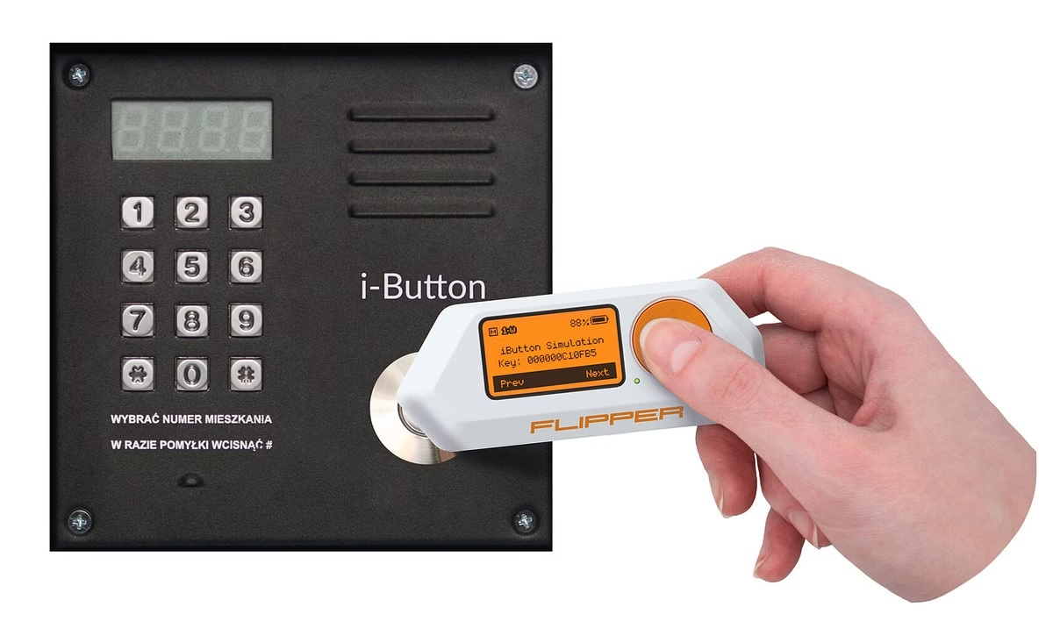
CYBER FORENSIC & SECURITY SOLUTION’S PROJECT:-
Exploring Flipper Zero in Cybersecurity
Flipper Zero is a versatile device that can be used for various purposes, including cybersecurity. This presentation will delve into the features, functionalities, and applications of Flipper Zero in the field of cybersecurity.
by Ahetesham Mopagar (Cyber Security Analyst Intern)

Slide 2


Introduction to Flipper Zero
Pocket-Sized
Open Source
The Flipper Zero is a small and portable device, making it easy to carry and use in various scenarios.
Its open-source nature allows developers to customize and extend its capabilities, making it a popular choice for security researchers and hobbyists.
Multi-Purpose
The Flipper Zero is designed for a wide range of applications, from security testing to hobbyist projects.

Slide 3

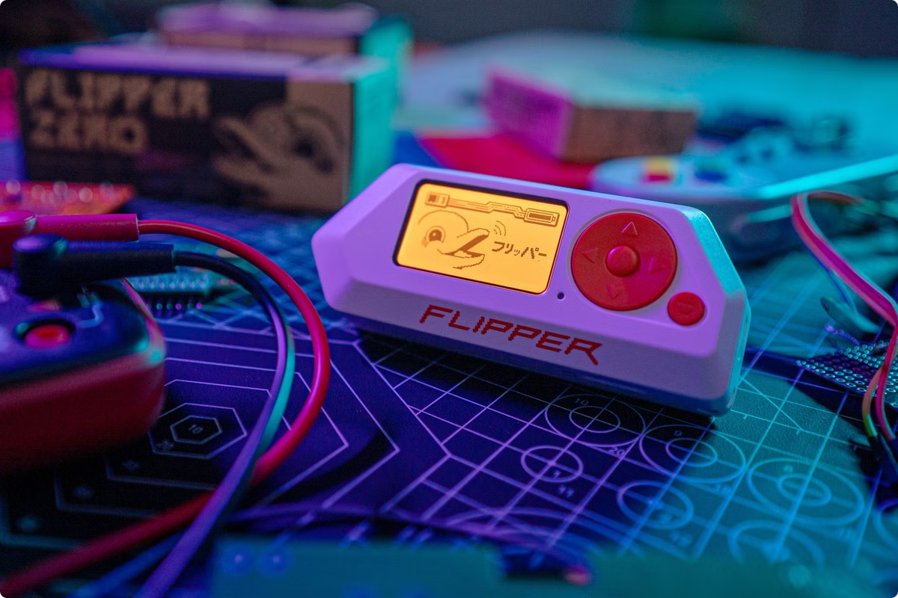
Features and Functionalities of Flipper Zero
1
RFID Reader and Emulator
2
Sub-Ghz Protocol Support
Flipper Zero can read, write, and emulate RFID tags, potentially allowing access to restricted areas or systems.
It can interact with various sub-Ghz protocols, including those used in keyless entry systems and garage door openers.
3
NFC Reader and Emulator
4
Infrared Blaster
It can send infrared signals to control various devices, such as TVs, set-top boxes, and air conditioners.
Flipper Zero can read and write NFC tags, which are commonly used in contactless payment systems and access cards.

Slide 4
Cybersecurity Applications of Flipper Zero
Penetration Testing
IoT Security Assessment
Security Research
The Flipper Zero can be used to identify security vulnerabilities in physical access systems, RFID tags, and other devices.
It can help assess the security of IoT devices and identify potential weaknesses that could be exploited by attackers.
Flipper Zero is a valuable tool for security researchers to explore new vulnerabilities and develop innovative security solutions.

Slide 5


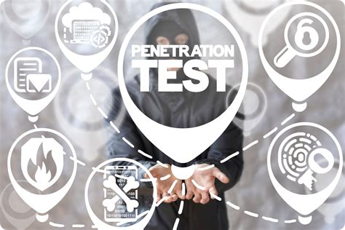


Utilizing Flipper Zero for Penetration Testing
Identify Targets
The first step is to identify the systems or devices that will be targeted for the penetration test.
Gather Information
Use Flipper Zero to scan for RFID tags, NFC tags, or other vulnerabilities in the target systems.
Exploit Weaknesses
If vulnerabilities are found, exploit them to gain access to the system or device.

Slide 6

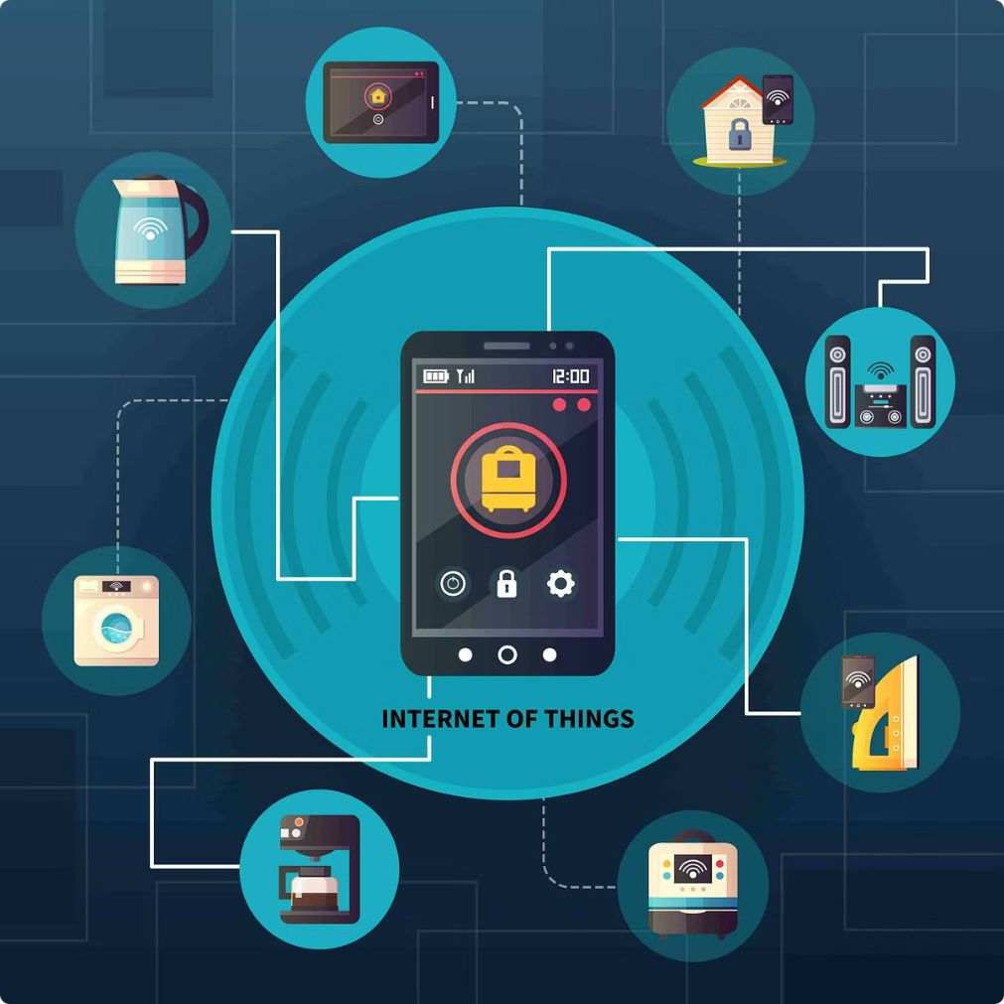
Flipper Zero as an IoT Hacking Tool
1
Device Enumeration
Flipper Zero can be used to scan for nearby IoT devices, such as smart lights, door locks, and security cameras.
2
Protocol Analysis
It can analyze the communication protocols used by IoT devices, identifying potential security weaknesses.
3
Attack Vectors
The Flipper Zero can be used to exploit vulnerabilities in IoT devices, potentially leading to unauthorized access or control.

Slide 7


Ethical Considerations with Flipper Zero
Responsibility
Use Flipper Zero for ethical purposes and only with proper authorization.
Privacy
Respect the privacy of individuals and organizations when using Flipper Zero for security testing.
Legality
Be aware of local laws and regulations regarding security testing and device hacking.

Slide 8

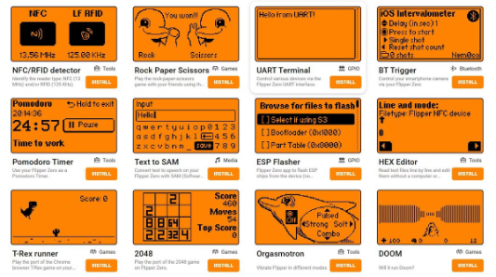



Conclusion and Future Developments
Versatile Tool
Security Awareness
Continual Evolution
Flipper Zero is a powerful tool that can be used for a wide range of cybersecurity applications.
It's important to be aware of the potential risks and ethical considerations associated with using Flipper Zero.
Flipper Zero is constantly evolving, with new features and capabilities being added regularly.

